Slide 1


“Global broadband connectivity through
LEO constellations”
ACMA RADCOMMS – Sydney, 30-31 October 2018
Tony Azzarelli - Vice President Global Licensing and Spectrum
Information included herein has been determined to not contain any controlled technical data or technology as these terms are defined under the International Traffic in Arms Regulations (ITAR) and
the Export Administration Regulations (EAR). Technical elaboration is not permitted for release without a prior review and separate release.

Slide 2

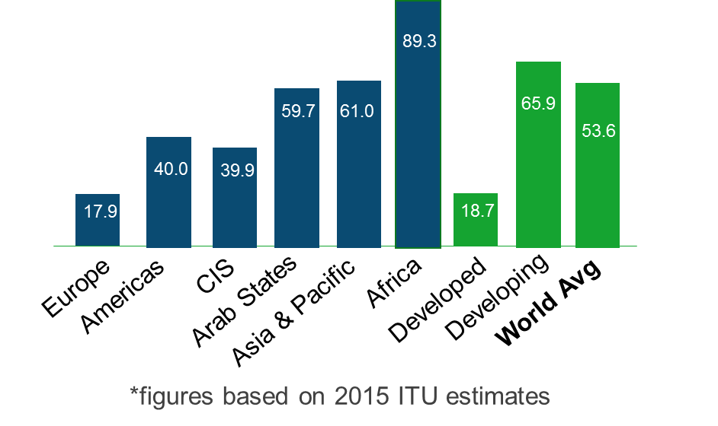
Digital Divide is everywhere
Not everyone is connected to the internet …
% of unconnected households
54% of the world has no Internet access
___________________________
Source: International Telecommunications Union (Geneva)
PROPRIETARY TO ONEWEB
1

Slide 3
… and Data Consumption is Growing Exponentially
Global IP Traffic Growth
Exponential grown in data consumption
is causing strain in connectivity
Satellite infrastructure can provide the needed connectivity:
- at no cost for governments
- and at lower cost per bit
(Exabytes per month)
24% CAGR
___________________________
Sources: Cisco VNI Global IP Traffic Forecast, 2016-2021
PROPRIETARY TO ONEWEB
2

Slide 4



OneWeb System Overview
Constellation
Ground Segment
Up to 882 satellites
Small & low cost satellites
1200 km altitude in polar orbit
1st satellite launch Q1-2019
Services from 2020/2021
Satellite terminals
  Low cost and low power
  Easy to install and without pointing
40 gateway sites across the globe
  Connected by global core network
Service link
Gateway link
Satellite Terminal
Gateway sites
PROPRIETARY TO ONEWEB

Slide 5





Backhaul Architecture
Access link
- WiFi, LTE, 5G
“Fibre in the Sky”
OneWeb Pipe
Global capacity of 8 Tbps
Latency of less than 50 ms
A truly global 5G enabler
MNOs
ISPs
Telcos
End-Users of
MNOs, Telcos, ISPs
PROPRIETARY TO ONEWEB

Slide 6
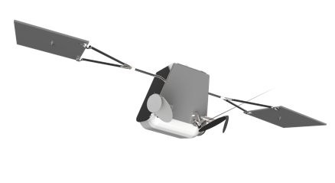

Backhaul Architecture
Access link
- WiFi, LTE, 5G
OneWeb
System
Feeder link
Service link
Ka-band
Ku-band
OneWeb Core
Network
MNOs
ISPs
Telcos
Gateway
site
Satellite
Terminals
End Users of
MNOs, Telcos, ISPs
PROPRIETARY TO ONEWEB

Slide 7

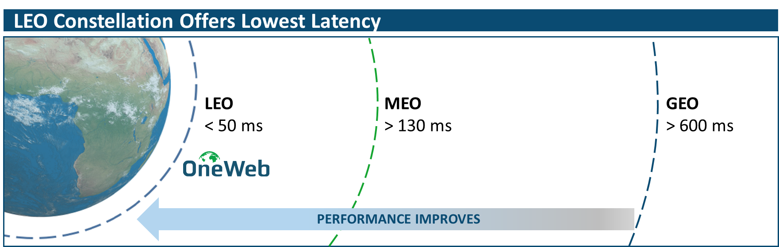
OneWeb Benefits and Key Advantages
  Truly global coverage
  Works in obstructed terrain (average elevation ~70°)
Low latency (~50 ms)
High broadband speeds (up to 100/450 Mbps)
Seamless and Ubiquitous mobility
… truly global 5G enabler
PROPRIETARY TO ONEWEB

Slide 8











OneWeb Serves Multiple Markets
Home / Small Enterprises
IoT / M2M / 5G small cells
Schools and Hospitals
Community Centres
Rural and Remote
Oil and Gas
Maritime
On-bard communications
Trains and vehicles
Connected cars
Public Protection and
Disaster Relief
Emergency
Roads / Motorways
Cellular Backhaul
PROPRIETARY TO ONEWEB

Slide 9




Satellite Equipment
mechanical
parabolic
Under development
    0.3 to 0.7 m size
Speeds up to 100/450 Mbps
    Parabolic & Phased array
    Low radiated power (35-39 dBW)
    High elevation operations
active
phased array
passive
phased array
PROPRIETARY TO ONEWEB

Slide 10
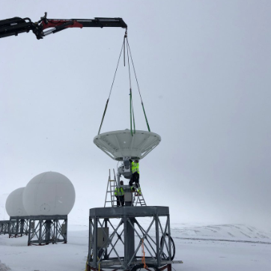
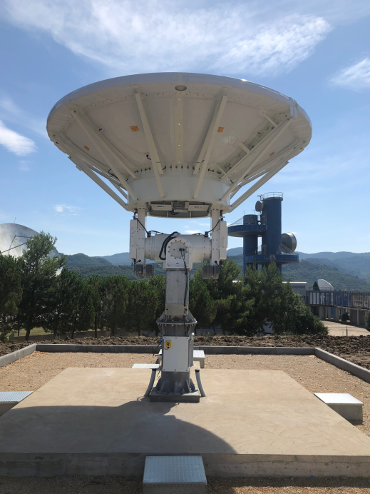
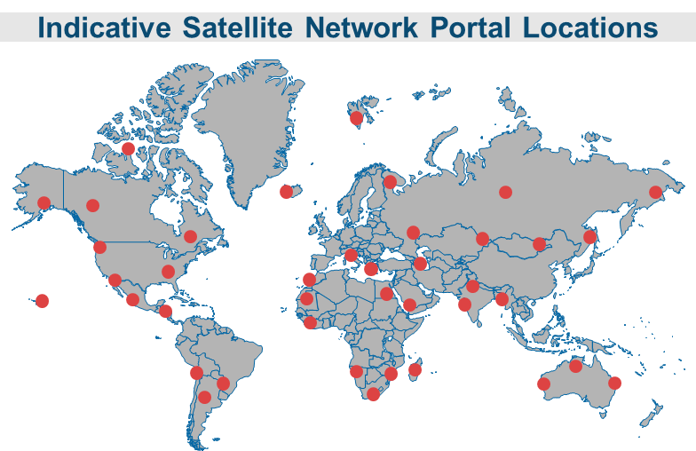
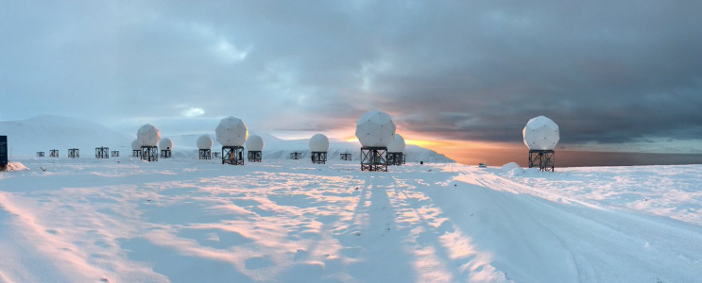
Gateway Deployment Overview
Indicative Gateway Locations
PROPRIETARY TO ONEWEB

Slide 11



Satellite Manufacturing
Joint Venture
Simple satellite architecture
High volume / Low cost production
Size - ~1 cubic meter & ~150 kg
Lifetime of more than 5 years
De-orbit Capability
PROPRIETARY TO ONEWEB

Slide 12
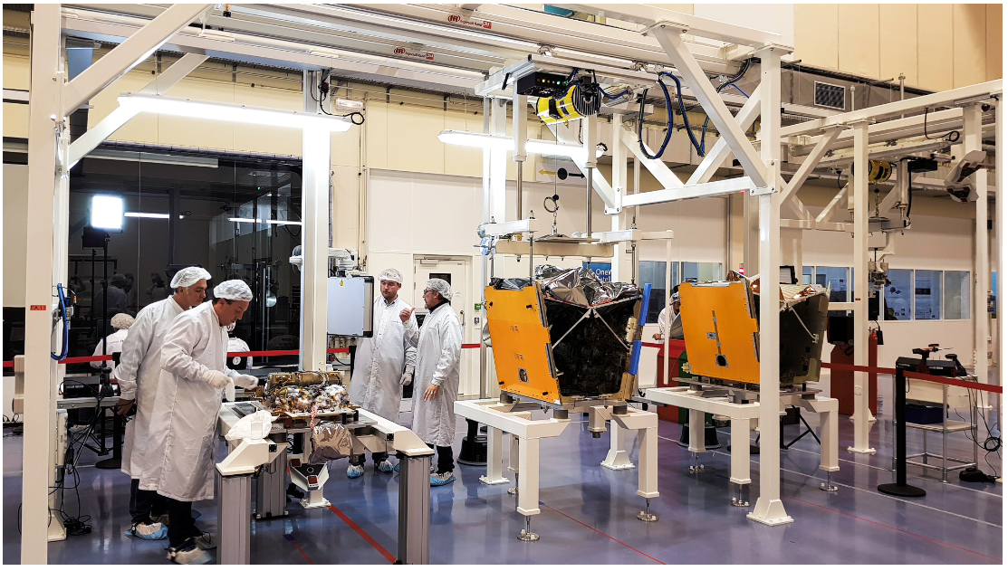
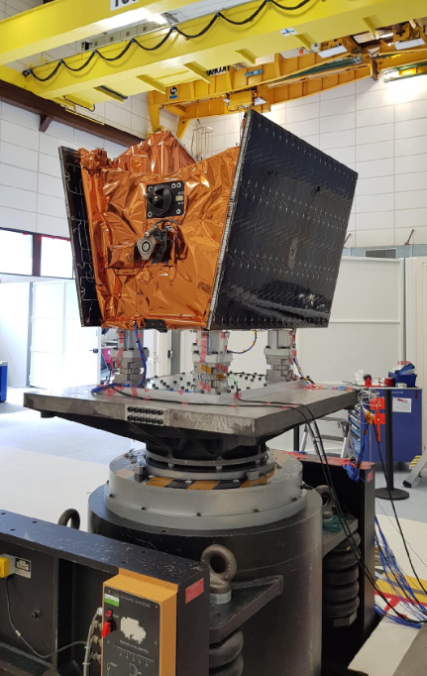
Satellite Manufacturing
PROPRIETARY TO ONEWEB

Slide 13
Spectrum Requirements
OneWeb operates in the Ku-band and Ka-band frequency allocations
  Allocations are assured by the ITU Radio Regulations set at WRC-2000
  Protection of GSO systems assured through Article 22 limits
  – ITU confirmed (Jan 2018) that OneWeb complies with these limits
 | User Link (Ku-band) | Gateway Link (Ka-band)
Space-to-Earth | 10.7 - 12.75 GHz | 17.8 - 20.2 GHz
Earth-to-space | 14.0 - 14.5 GHz | 27.5 - 30 GHz
PROPRIETARY TO ONEWEB

Slide 14
Licensing requirements – in General
Several types of license and authorizations may be required
Spectrum Use
  ITU satellite filings – UK, France
  Satellite equipment – Exempted, Class license, Blanket Authorizations
  – Type Approval
  Gateways – Coordination and License
Services
  We work with local service partners to acquire these authorizations
  Licensing varies from country to country
Ground Network
  Depend where the access points lie – may require a license/authorization
Space Operations
  UK launch and space operations license
PROPRIETARY TO ONEWEB
13

Slide 15
Licensing Worldwide: fragmented and complex
Satellite operators require regulations that benefit end-users everywhere
  Regulations need to be clear, flexible and low cost
The reality is very different and can hurt the countries themselves
Region | Licensing methodology | Regulation’s attributes
Europe | Flexible, low cost and harmonised | Embraces innovation and connectivity
Latin America North America Africa Asia Middle East CIS | Generally complex and protective | Hinders innovation and connectivity
PROPRIETARY TO ONEWEB

Slide 16
Policymaking Needs to Fosters Connectivity
Policymaking needs to fosters
the deployment of satellite services for the benefit of users
Regulations that foster:
Are Win-Win-Win
(operator, country, citizens)
Technology Neutrality and Competition
Light touch Licensing
Free circulation of equipment
Self declaration of compliance to ETSI standards
Cost recovery fee, or no fee approach
Higher connectivity and sooner
Access everywhere
Mass market deployment
Affordable Equipment
Affordable Services
High Quality of Services
PROPRIETARY TO ONEWEB
15

Slide 17
Licensing in Europe: fosters innovation and market access
Europe has a simplified approach to licensing - General Authorization Directive
Services and Use of Spectrum
– Can be exempt from license, or light touch licensing
– Fees are either none or based on cost recovery
– Through harmonized ECC Decisions and ETSI standards
Satellite equipment – Exempted from individual license
– requires an ETSI equipment standard
  – requires type approval testing and CE marking
Gateways – Require frequency coordination and a license
– Fees based on cost recover
ECC – Electronic Communications Committee
ETSI – European Telecommunications Standards Institute
CE – a marking approved by the European Commission
PROPRIETARY TO ONEWEB
16

Slide 18

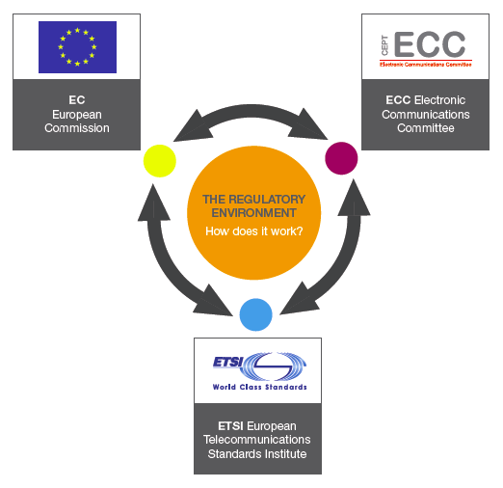


Licensing in Europe: an interplay between three bodies
European Union (28)
Creates an
harmonised and binding regulations
(foster single market approach)
Mandate studies
Electronic Communication
Commission (ECC)
CEPT (48)
Creates an
harmonised and
non-binding regulations
(foster efficient use of spectrum)
ECC Report
European
Regulatory
Environment
Technical Exchanges
Spectrum allocations
Harmonised Standards
ETSI (36)
Creates
equipment standards
that avoid harmful interference
and create market scale
PROPRIETARY TO ONEWEB
17

Slide 19
OneWeb fosters Clean Space by Taking Responsible Measures
Launch license from the UK
OneWeb system features:
  Positional knowledge of satellites (by GPS and radars)
  Maneuverability and deorbiting of satellite
  Spacecraft designed for demise at re-entry
  High reliability of deorbit components (e.g., electric propulsion)
  In-orbit flight coordination
  Deorbiting infant mortality at launch phase
PROPRIETARY TO ONEWEB

Slide 20
Tony Azzarelli
Vice President Global Licensing and Spectrum
tony@oneweb.net
PROPRIETARY TO ONEWEB

