Slide 1
Radcomms 2018 Spectrum futures
Five Year Spectrum Outlook evolution
Workshop

Slide 2
Overview
FYSO evolution – 2009 to today
Demand drivers and supply drivers – questions for discussion

Slide 3
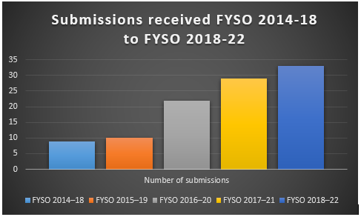
FYSO – submissions received
Steady increase in submissions received as shown in the chart below
Feedback can be sent to spectrumworkprogram@acma.gov.au
Notes:
As the chart above shows, stakeholder feedback continues to grow as FYSO evolves.

Slide 4
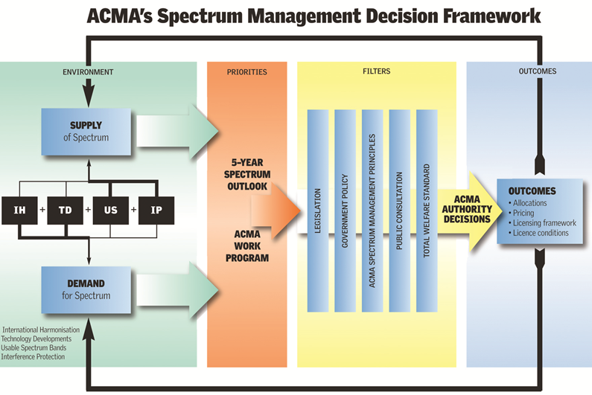
Spectrum Management Decision Framework
  Spectrum management principles are available on the ACMA website

Slide 5
Questions for discussion
Demand drivers
1. The FYSO identifies demand for satellite, broadcasting, 5G and mobile broadband, dynamic spectrum access developments.
What are the other top technology trends the ACMA should be monitoring that will affect spectrum demand?
2. How do technology developments influence substitution of spectrum demand between
  Licenced and unlicensed (class licensed) spectrum
  Services like fixed and wireless, satellite and wireless?
Supply drivers
3. Are there opportunities for industry led optimisation of spectrum utilisation?
Notes:
The purpose of today’s session is to discuss the demand drivers and supply drivers that inform the ACMA work program and FYSO. But today, the purpose of this session – mainly looking to inform Part 1 of the FYSO which discusses the environment outlook for spectrum demand and supply.

Slide 6
THANK YOU
Linda Caruso
Executive Manager
Spectrum Reform Implementation Branch
Communications Infrastructure Division

