Slide 1
Session 9 - Radcomms 2018
“Defragmentation Dividend”

Slide 2
Key perspective
Mobile sits at the heart of an
enabling ecosystem that is uniting
digital, physical and biological worlds.

Slide 3
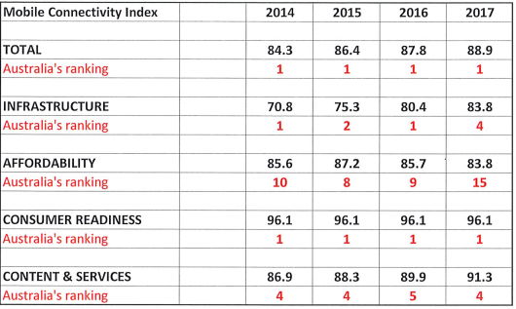
Global Mobile Connectivity Index
163 Nations
(GSMA)

Slide 4
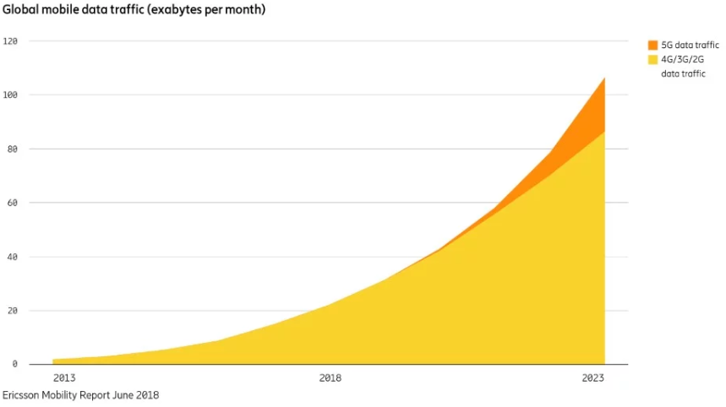
Global mobile data traffic growth
2010 - 2015 forecast
2018 - 2023 forecast
60
Exabytes per Month
50
40
Data
Exabytes per Year
30
20
Voice
10
0
2008
2009
2010
2011
2012
2013
2014
2015
Source: Ericsson

Slide 5

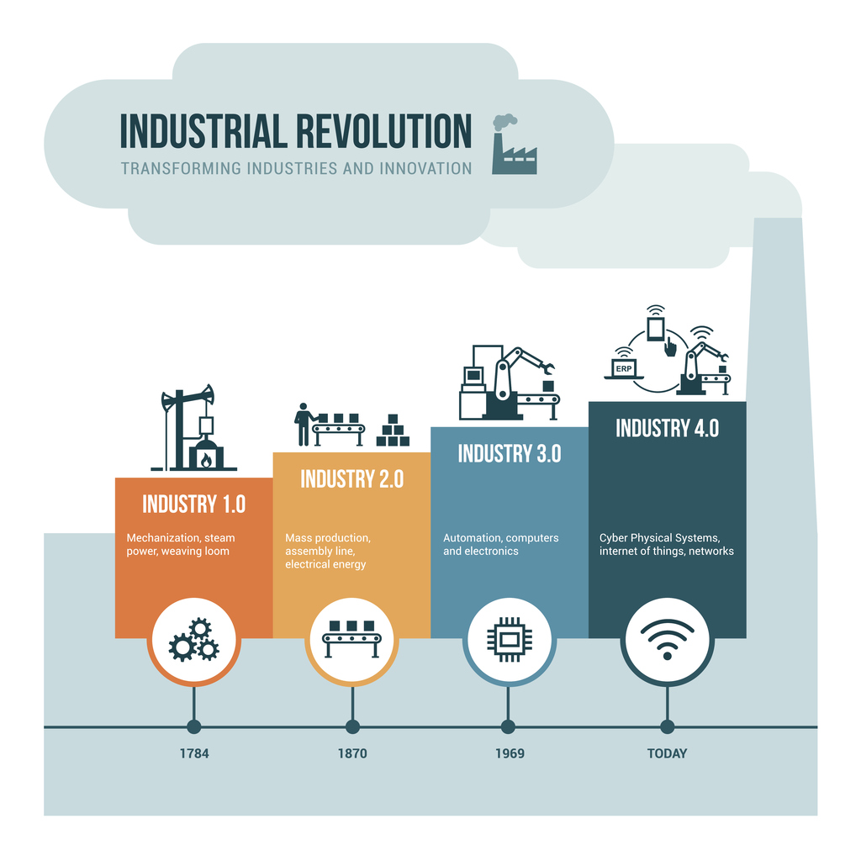
Where are we headed?
Fourth Industrial Revolution
Physical
+
Digital
+
Biological

Slide 6

Convergent Ecosystem

Slide 7









Innovation Investment
Infrastructure
Meeting customer demand for latest generation mobile devices, apps and services depends on industry investing $$billions in:
latest generation technologies – the “Gs”
network infrastructure and
radio-frequency spectrum

Slide 8
Key Issues for Mobile Industry
Minimise regulatory burden – maximise opportunity
Focus on policy and regulatory settings:
5G evolution
Spectrum policy
5G bands needed
Network deployment

Slide 9
Spectrum Policy Reform
SPECTRUM REVIEW – agreed 2012 – commenced 2014
A comprehensive reform of the framework – new Radcommunications legislation.
Principles of:
    simplicity,
    flexibility,
    transparency,
    certainty and
    efficiency

Slide 10
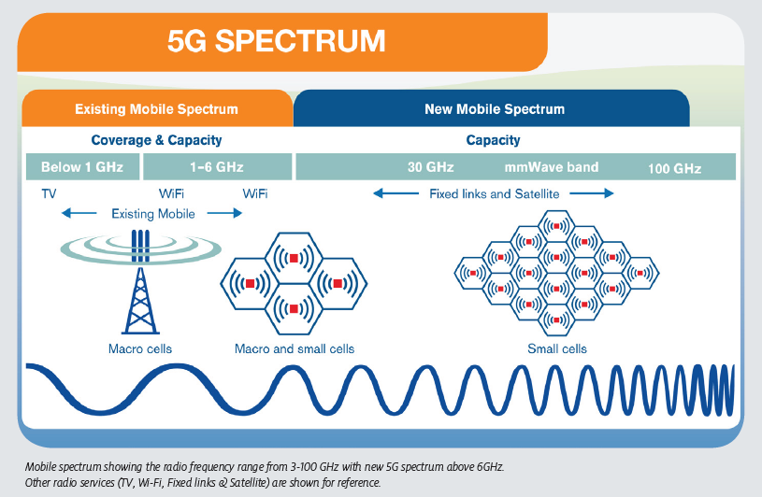
Spectrum mix

Slide 11
Conclusion
Strong data growth forecasts – continue
Video, IoT / M2M will drive new growth
Mobile role and influence increasing via 4 - 5G ecosystem
economic (productivity) and social (connectivity)
Policy and regulatory focus must support mobile evolution to 5G:
  Innovation
  Investment
  Infrastructure - network deployment and spectrum

Slide 12

Thank you

