Slide 1
mmWave Wireless broadband: a spectrum planning perspective
NOTE – PLEASE DELETE FROM PRESENTATION: This is a 16:9 widescreen template suitable for screen presentation. If your presentation is for an external event, please check with the venue what size is required. Please contact DL Editorial Services if you require a 4:3 size template.
Chris Worley
Senior Engineer, ACMA

Slide 2
Why mmWave?
UHF
SHF
24 GHz
86 GHz
VHF
EHF
100 MHz
100 GHz
Current mobile range
mmWave range

Slide 3
Why now?
1800 MHz
26 GHz

Slide 4
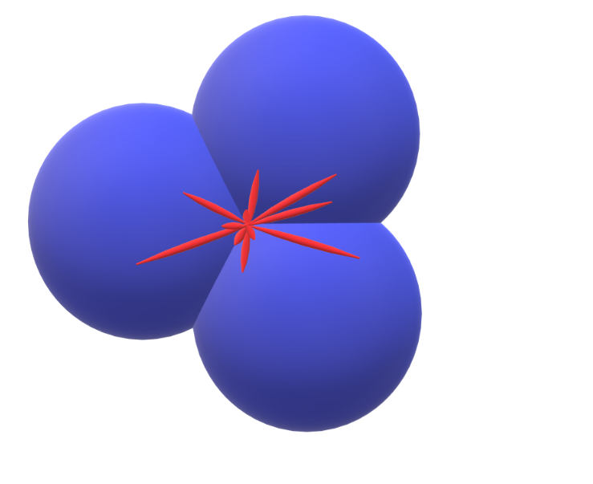
Why now?
1800 MHz
26 GHz with beam-forming

Slide 5
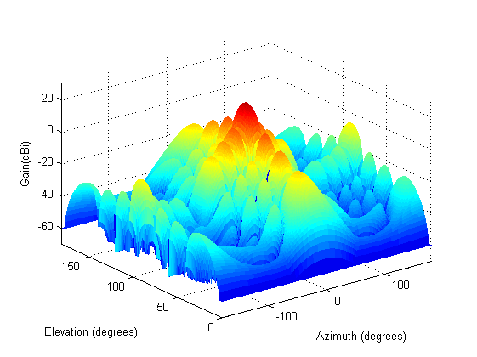
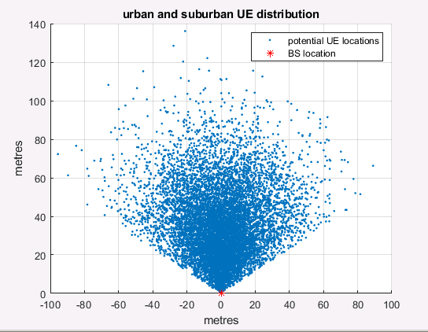
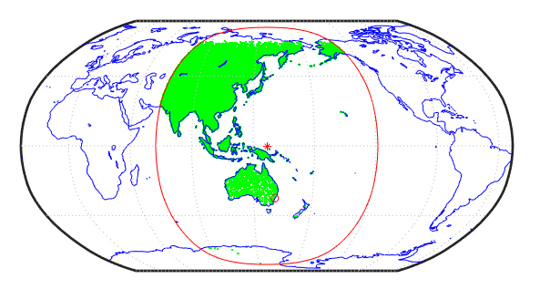
Challenges and opportunities

Slide 6
26 GHz study focus mmWave?
EESS
Potential wireless broadband
FSS (E-s)
24 GHz
27 GHz
27.5 GHz
23.6 GHz
24.25 GHz

Slide 7
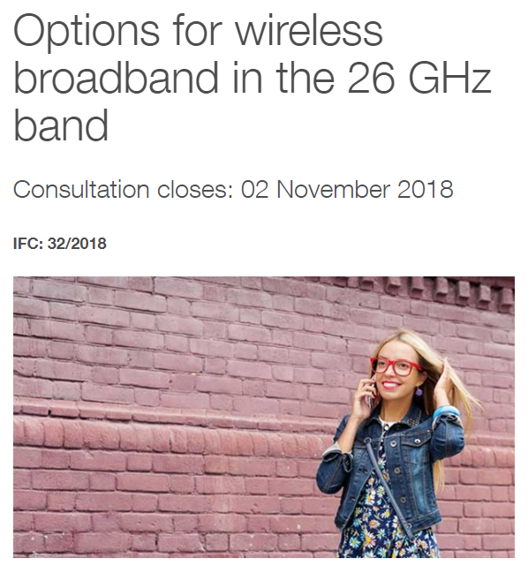
Domestic planning underway: 24.25–27.5 GHz

Slide 8
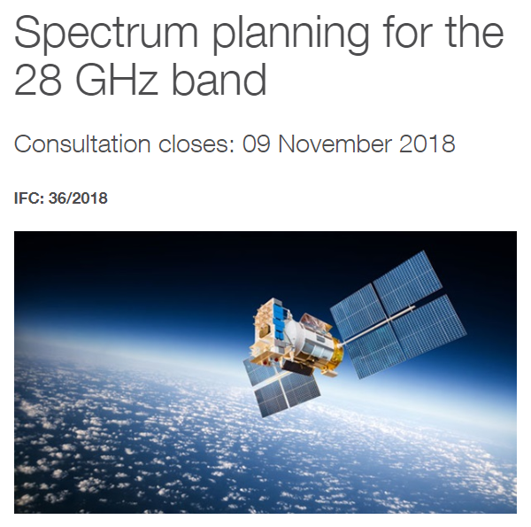
Domestic planning underway: 27.5–29.5 GHz

Slide 9
Domestic planning underway: 57–66/71 GHz

Slide 10
