Slide 1
Updated user guide
ACMA WAS network capacity forecasting model
10 June 2015
Loïc Tchoukriel-Thébaud and Philip Bates

Slide 2
Confidentiality notice
Copyright © 2015. The information contained herein is the property of Analysys Mason Limited and is provided on condition that it will not be reproduced, copied, lent or disclosed, directly or indirectly, nor used for any purpose other than that for which it was specifically furnished

Slide 3
Contents
Overview
Excel formulae used
Market parameters and assumptions
Network parameters and assumptions
Network calculations
Results

Slide 4
Overview
Excel formulae used
Market parameters and assumptions
Network parameters and assumptions
Network calculations
Results

Slide 5
Background
Overview
In 2013, Analysys Mason was engaged by the Australian Communications and Media Authority (ACMA) to undertake a study to forecast the future need for infrastructure for wireless access services in Australia (reference 13ACMA013)
As part of this study Analysys Mason built an Excel model for the ACMA to assess the impact of spectrum on the number of cell sites required by Australian mobile operators
The model is also used to generate cost inputs for a study undertaken by The Centre for International Economics (The CIE) and Analysys Mason on the impact of mobile broadband on the Australian economy and society (reference 13ACMA014)
The ACMA originally asked Analysys Mason to prepare this user guide to assist respondents to its public consultation on the model.
This version excludes any information that may be considered confidential.

Slide 6
Overview of the model
Overview
The model calculates the number of sites and site upgrades required for one operator at a time, given a set of assumptions about:
  the area to be covered by each technology (2G, 3G, 4G)
  the volume of traffic to be carried by each technology
  the spectrum available for each technology (by spectrum band)
  the spectral efficiency of each technology
By altering the above inputs the model can be used to investigate the impact of assuming that different amounts of spectrum are available under different traffic and roll-out scenarios
Relevant sets of parameters for Optus, Telstra and Vodafone are already stored in the model
To speed up operation, there is a macro which will run the model for each operator in turn and paste all the results into output sheets
Various sensitivities are also pre-programmed and two further macros are used to run them
In addition, the model produces a high level estimate of the radio access network cost associated with the current set of results (to provide the inputs needed by The CIE’s economic impact model which was also commissioned by the ACMA in 2013)
To protect the confidentiality of various inputs provided by the operators, some of the original data has been replaced by public domain information, Analysys Mason’s own intelligence or dummy data in the version of the model released for consultation. Consequently, this version of the model does not calculate the same results as the confidential version built for the ACMA.

Slide 7
Logical flow of model
Overview
Subscribers by technology
Traffic distribution by geotype
Spectral efficiency by technology
Spectrum available by technology
Cell radii
Network coverage by geotype
Traffic per subscriber by technology
Share of uplink and downlink traffic
1
Inputs
Basic and maximum capacity of each coverage site by technology in Mbit/s
Number of coverage sites by geotype
Traffic forecast in Mbit/s per annum by geotype
2
Calculations
Site upgrades and extra sites required for capacity
3
Results
Distance of traffic from cell centre
Proportion of traffic that can be carried by high frequency spectrum
4
Post-processing

Slide 8
List of worksheets contained in the model and Analysys Mason’s cell formatting conventions
Overview
The first sheet of the model, labelled “INTRO”, includes a list of all the worksheets contained in the model, along with a brief description of each of each
The table below presents the different formatting conventions used in the model
Sometimes the “Data calculated based on a trend line” and “Data calculated from other inputs” are both used in a given block of calculations to indicate that the formula is not the same for the whole block (for example one formula for the first three rows and a different one for the last two)
Links | External link | 100
 | Local link | 100
Data | Parameter defined by the user | 100
 | Real piece of data | 100
 | Estimate used in the absence of real data | 100
 | Data calculated from other inputs | 100
 | Data calculated based on a trend line | 100
 | Output of a sheet or workbook | 100
 | Parameter linked to a sensitivity | 100
 | Dummy value (to protect the confidentiality of inputs provided by the operators) | 100
Other | Checksum | TRUE
 | Excel name of a list or a single cell | Name

Slide 9
Overview
Excel formulae used
Market parameters and assumptions
Network parameters and assumptions
Network calculations
Results

Slide 10
About calculations (1/2): (INDEX, MATCH)
Excel formulae used
The model makes considerable use of Excel’s INDEX and MATCH functions, which work as follows:
  MATCH(lookup_value, lookup_array, match_type)
    lookup_value is the value searched in a list
    lookup_array is the list in which the value is searched
    match_type: we always use “0” in this model, meaning we want an exact match of the lookup_value in the lookup_array
    the MATCH formula returns a single number, which is the position of the lookup_value in the lookup_array
    For example, if we search for the value “base case” in the list “-50% traffic; base case; +50% traffic”, the result of the MATCH formula will be “2”
  INDEX(array, row_number, column_number):
    array is the list in which the value to be returned is contained
    row_number is the row number of the value to be returned from the array
    column_number is the column number of the value to be returned from the array
    if the array is only one column wide, the column_number can be left blank, and the formula be of the format INDEX(array, row_number, )
    INDEX(array, MATCH(lookup_value, lookup_array, 0),) therefore finds the position of the lookup_value in the lookup_array and returns the value from the one column-wide array at this row position

Slide 11
About calculations (2/2): OFFSET
Excel formulae used
The model also makes use of Excel’s OFFSET function to introduce a decommissioning delay when equipment is no longer required to carry the volumes of traffic on the network modelled (for example, as a result of the transition from 3G to 4G data)
In case you are not familiar with the function, it works as follows:
  OFFSET(reference, rows, columns, height, width)
    reference is the initial cell to consider
    rows is the number of rows away from the reference from which the offset starts (if 0 or left blank, the offset starts on the same row as the reference)
    columns is the number of columns away from the reference from which the offset starts (if 0 or left blank, the offset starts on the same column as the reference)
    height is the height in rows of the array which is the result of the offset (if left blank, height of 1)
    width is the width in rows of the array which is the result of the offset (if left blank, width of 1)
  In the model, if the decommissioning delay is X years and the reference year is N, we look back X years in time at the maximum number of equipment needed each year based on coverage and capacity requirement, i.e. from the year N-X to the year N, and the number of equipment required after decommissioning is this maximum

Slide 12
Overview
Excel formulae used
Market parameters and assumptions
Network parameters and assumptions
Network calculations
Results

Slide 13
Market parameters and assumptions (1/3: subscribers)
Market parameters and assumptions
The “MKT” sheet contains all the inputs and calculations about the total Australian mobile market
Number of subscribers:
  Penetration is calculated separately for each type of device (from known population and subscribers numbers for the early years of the model)
  The number of subscribers for later years is estimated by multiplying a forecast of population (from the Australian Bureau of Statistics) by a forecast of penetration
  For example:
Split of subscribers by technology:
  Handset subscriptions are first split into handset data subscriptions and handset voice-only subscriptions
  For each type of device using data, subscriptions are then split into LTE subscriptions and 3G subscriptions
 |  |  | Source | Unit |  | 2010 | 2011 | 2012 | 2013 | 2014 | 2015
Mobile subscribers, EOP
 |  | Population | Australian Bureau of Statistics (ABS) | thousand |  | 22,173 | 22,512 | 22,906 | 23,239 | 23,572 | 23,906
 |  | Population penetration of handsets |  |  |  | 93% | 94% | 93% | 94% | 95% | 96%
 |  | Total handset subscriptions | GSMA | thousand |  | 20,657 | 21,102 | 21,255 | 21,801 | 22,354 | 22,915

Slide 14
Market parameters and assumptions (2/3: penetration and traffic)
Market parameters and assumptions
Device penetration:
  The device penetration is first forecast as “end of period” (EOP) numbers
  However, to calculate the volumes of traffic in each year we need the average number of devices across each year; we need “average of period” (AOP) numbers of devices
  The AOP number for the year N is calculated as the EOP number for the year N and the EOP number for the year N-1
  The AOP number of devices is then multiplied by the annual volume of traffic in year N per type and technology of device (for example data per 4G handset) to obtain the total annual traffic
Traffic per device
  The traffic is forecast per device
  For voice traffic, there is only one forecast for both type of handsets (voice-only or voice and data)
  For data traffic, there is one forecast per type of device and per technology (such as 3G handset, 3G tablet, 4G dongle/laptop, etc.)
Total traffic
  The number of devices is multiplied by the traffic per device to obtain the total volumes of traffic carried on Australian mobile networks

Slide 15
Market parameters and assumptions (3/3: charts)
Market parameters and assumptions
Handset subscribers (thousands)
Connected tablets subscribers (thousands)
Dongle/laptop subscribers (thousands)
Monthly data traffic per device (MB)
Source: Analysys Mason; these charts can be found in the model in the “Charts >>” section

Slide 16
Overview
Excel formulae used
Market parameters and assumptions
Network parameters and assumptions
The “CTRL” sheet
The “IN” sheet
Geotypes
National roaming and commuting
Traffic
Coverage
Capacity
Network calculations
Results

Slide 17
The “CTRL” sheet (1/4)
Network parameters and assumptions – the “CTRL” sheet
The “CTRL” sheet contains most of the parameters that can be selected/updated/modified before running the model; it contains the following sections:
  Operators: to select the operator for which the model is run
  Market share: indicates the market share by geotype of all three operators and the operator selected
  Sensitivities: contains the various sensitivities built in the model and the values which can be selected for each of them in a drop-down menu
    For example:
  For each sensitivity, the parameter used in the base case has been highlighted and labelled as “base case” in the model
    For example:
  The following sensitivities are included (note that this list continues on the next two slides):
    Extra usage: determines the increase/decrease of traffic in 2020 compared to the base case
    Exponential 4G data traffic growth: makes 4G data traffic growth exponential
    Data traffic in the busy hour: percentage of data traffic in the busy hour; the value in 2011 and the value in 2027 can be chosen to be different, with a linear interpolation between the two
0% | sensitivity.traffic.selected
Data traffic in the busy hour
 | Proportion in 2011 |  | 7%
 |  | 7 % (base case) | 7%
 |  | 11 % | 11%
 |  | 7 % | 7%

Slide 18
The “CTRL” sheet (2/4)
Network parameters and assumptions – the “CTRL” sheet
    Extra spectrum:
      Include the use of the 2.3GHz band (for Optus): adds the 2.3GHz band as an LTE band used for mobile services for Optus
      Additional spectrum for spectrum sensitivity:
      Run spectrum sensitivity: selects which spectrum scenario is run; spectrum can be added at the national level or at the level of a spectrum allocation area (metropolitan, regional, remote)
      Amount of extra spectrum by operator: selects how the additional spectrum is split between operators
    Less spectrum: removes the spectrum in the 700MHz and the 2.5GHz bands from the spectrum allocation of the operators
    Spectral efficiency:
      Multiplier: determines the multiplier to apply to the base case target value of spectral efficiency (in 2028) for 3G and 4G
      Ratio of low to high frequencies spectral efficiency target value in LTE: as the name indicates
    Distribution of traffic: determines whether the traffic is distributed homogeneously or following a curved distribution across the sites of a given geotype
    Shutdown of 2G: indicates whether 2G services are shut down or not and if they are shut down, which year this happens (year can be selected by operator)
    Shutdown of 3G: same as shut down of 2G but for 3G networks

Slide 19
The “CTRL” sheet (3/4)
Network parameters and assumptions – the “CTRL” sheet
    Level of infrastructure (sites) sharing: indicates the percentage of new sites deployed because of LTE which are shared with at least one other operator
    Site lifetime: indicates the lifetime of a physical sites; only influences the cost results of the model, not the asset dimensioning
  Spectrum allocations:
    Spectrum allocations (2*X MHz): indicates the amount of spectrum owned by each operator in each spectrum band, including the impact of the “Include the use of the 2.3GHz band” and “Less spectrum” spectrum sensitivities; the model distinguishes the volumes of spectrum which are allocated on a national, metropolitan areas, regional areas or remote areas basis
    800MHz spectrum allocations used for LTE over time (rather than 3G; 2*X MHz): indicates for each operator and year how much spectrum in the 800MHz band is used to provide LTE rather than 3G services
    900MHz spectrum allocations used for 3G over time (rather than 2G; 2*X MHz): similar for another band (900MHz) and other technologies (3G and 2G)
    1800MHz spectrum allocations used for LTE over time (rather than 2G; 2*X MHz): similar logic
    2.1GHz spectrum allocations used for LTE over time (rather than 3G; 2*X MHz): similar logic
  Population and commuting options (continues on the next slide):
    Population: proportion of the growth of population that goes to the three densest geotypes: determines the proportion of the national population growth that occur in the urban/suburban areas rather than the rural/remote areas

Slide 20
The “CTRL” sheet (4/4)
Network parameters and assumptions – the “CTRL” sheet
    Commuting: indicates how much of the population of each geotype commutes into denser geotypes (net of the population commuting in the other direction), how these commuters are split between denser geotypes, and how much of the traffic they generate occurs in the denser geotypes they commute into
  National roaming options:
    Use of national roaming: indicates whether an operator uses national roaming or not
    Parameters of the operator to which national roaming is provided, by operator: indicates, for each operator, the other operator for which it provides national roaming
    Traffic that uses national roaming on another network (if any): indicates the proportion of traffic generated in each geotype by the subscribers of an operator using national roaming carried by the network of the operator which provides national roaming
  Small cells options: indicates the number of small cells in each geotype and the proportion of the total traffic they carry
  Coverage options: lists the coverage options defined in the “IN” sheet
  Usage of TDD spectrum: indicates the proportion of TDD spectrum which is used to carry downlink traffic
  Delay before decommissioning: indicates how many years active equipment and physical sites are kept in the network after they are no longer needed for coverage or capacity reasons (the idea being that if they may be needed again at a later stage it is cheaper to pay for their opex for a few years when they are not needed than to deploy them again and pay for their capex again later)
Some of these parameters are described in more details in the remainder of this section

Slide 21
Overview
Excel formulae used
Market parameters and assumptions
Network parameters and assumptions
The “CTRL” sheet
The “IN” sheet
Geotypes
National roaming and commuting
Traffic
Coverage
Capacity
Network calculations
Results

Slide 22
The “IN” sheet
Network parameters and assumptions – the “IN” sheet
The “IN” sheet contains some parameters which are in this sheet rather than the “CTRL” sheet because:
  a) they are more technical parameters which should not need to be modified or
  b) they are what we consider to be the most relevant values for these parameters and therefore should not need to be modified either or
  c) they are base case values which can already be modified by a sensitivity in the “CTRL” sheet
It contains the following sections:
  Demand forecast: simply collects volumes of traffic from the “MKT” sheet and applies the market share of the operator modelled and the operator to which it provides national roaming if any
  Busy hour calculation: transforms the volumes of annual traffic to the volumes of traffic in the busy hour
  Calculations for 2G:
    Coverage: 2G coverage parameters (population and area coverage) and cell radii in each band separately for 2G, 3G and 4G
    Capacity calculation: capacity parameters and calculations to determine the 2G capacity per site in each spectrum band by type of area (metropolitan, regional, remote)
  Calculations for 3G / Calculations for LTE: similar parameters and calculations for 3G and LTE
Some of these parameters are described in more details in the remainder of this section

Slide 23
Overview
Excel formulae used
Market parameters and assumptions
Network parameters and assumptions
The “CTRL” sheet
The “IN” sheet
Geotypes
National roaming and commuting
Traffic
Coverage
Capacity
Network calculations
Results

Slide 24
Geotypes and spectrum allocations (1/2)
Network parameters and assumptions – geotypes
The geotypes are defined in the “GEO” sheet. As indicated earlier, the spectrum allocations are defined in the “CTRL” sheet, section “Spectrum allocations”
The model calculates the number of sites required at a national level by ‘geotype’, i.e. dense urban, urban, suburban, rural and remote areas
The geotypes are defined on the basis of the population density of “Statistical areas level 2” (SA2)¹, of which there are 2200 in total² as follows:
  Dense urban: more than 3,000 inhabitants per square kilometre
  Urban in metropolitan areas: 1,250 to 3,000 and in one of the eight metropolitan areas defined by the ABS
  Urban in regional areas: 1,250 to 3,000 and outside of metropolitan areas
  Suburban in metropolitan areas: 100 to 1,250 and in a metropolitan area
  Suburban in regional areas: 100 to 1,250 and outside of metropolitan areas
  Rural: 0.2 to 100
  Remote: less than 0.2
In the rural and remote geotypes, we have excluded the SA1s with fewer than 10 inhabitants or a population density below 10% of the population density of their parent SA2 from the areas to be covered, since we think that in practice the operators are unlikely to cover these areas
Sources:
1: http://www.abs.gov.au/ausstats/abs@.nsf/Latestproducts/88F6A0EDEB8879C0CA257801000C64D9?opendocument
2: http://www.abs.gov.au/AUSSTATS/abs@.nsf/DetailsPage/3218.02012?OpenDocument

Slide 25
Geotypes and spectrum allocations (2/2)
Network parameters and assumptions – geotypes
We have assumed that the metropolitan spectrum allocations apply in the dense urban, and urban and suburban geotypes in metropolitan areas. The regional allocations apply in the urban and suburban geotypes in regional areas and in the rural geotype. National allocations also apply in the remote geotype.
  Urban and suburban SA2s have been allocated to metropolitan or regional areas depending on whether they are within a metropolitan area or not
  The threshold of population density between the rural and remote geotypes has been chosen to get a close match between the regional licensing areas and the rural geootype
It is also worth noting that in some bands operators have different amounts of spectrum in different metropolitan (and sometimes regional) areas. Where this happens we have had to use average values

Slide 26


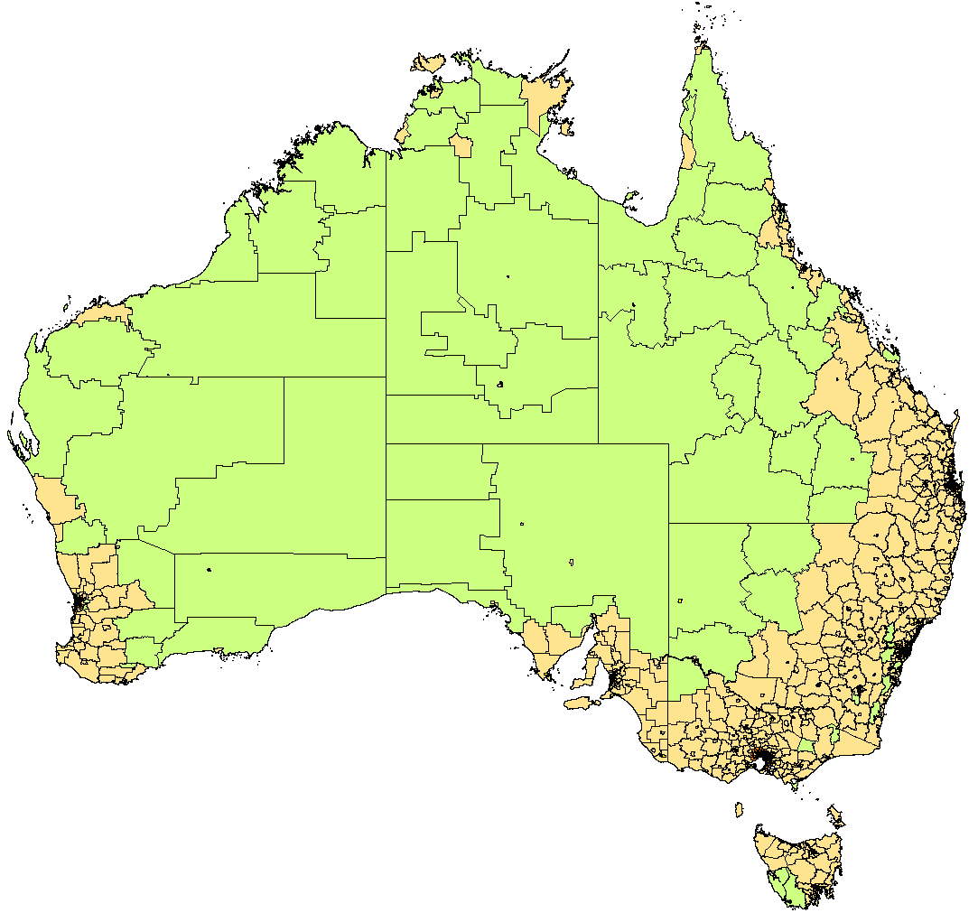
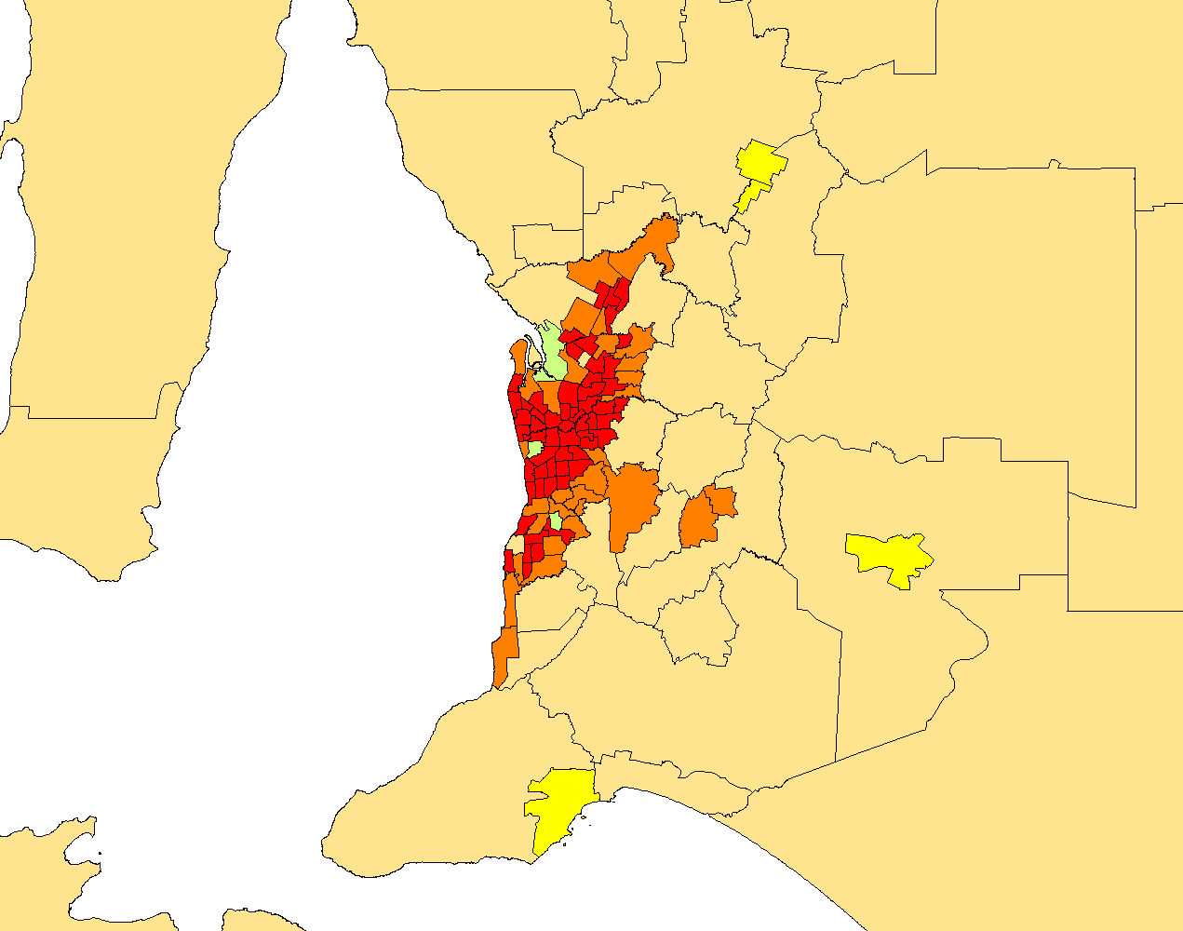
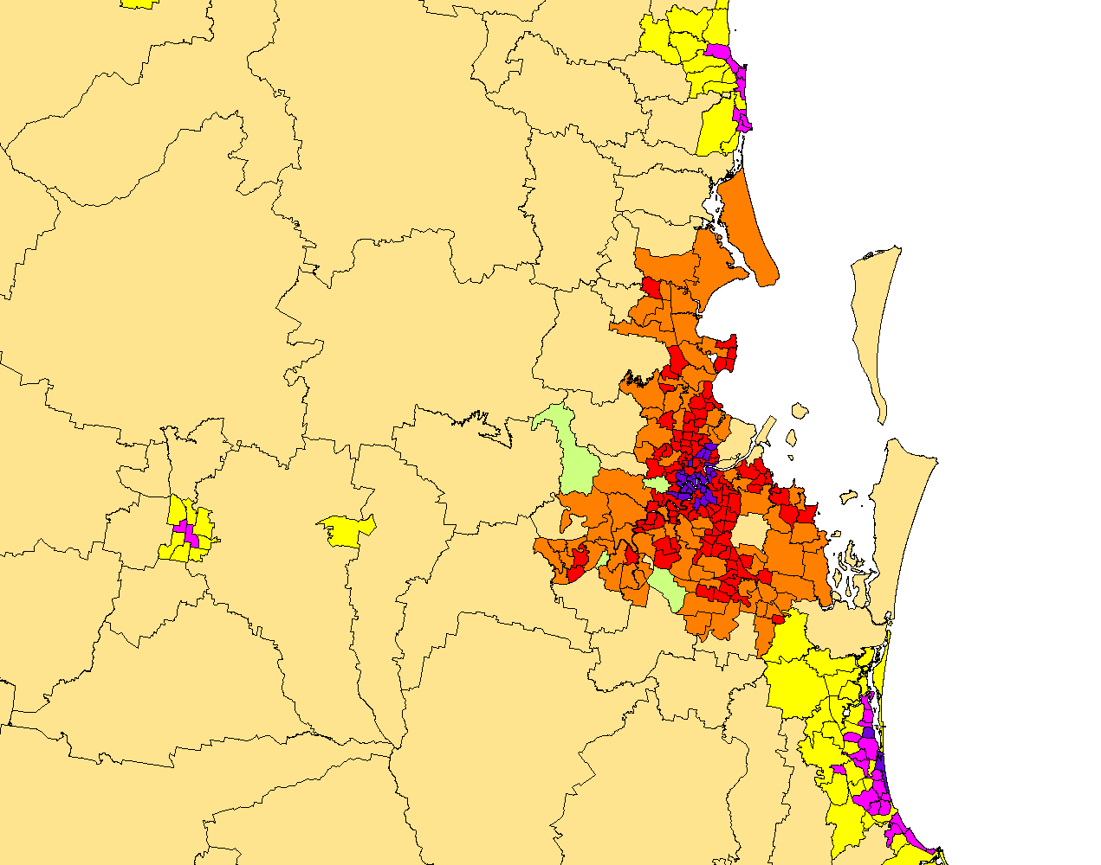
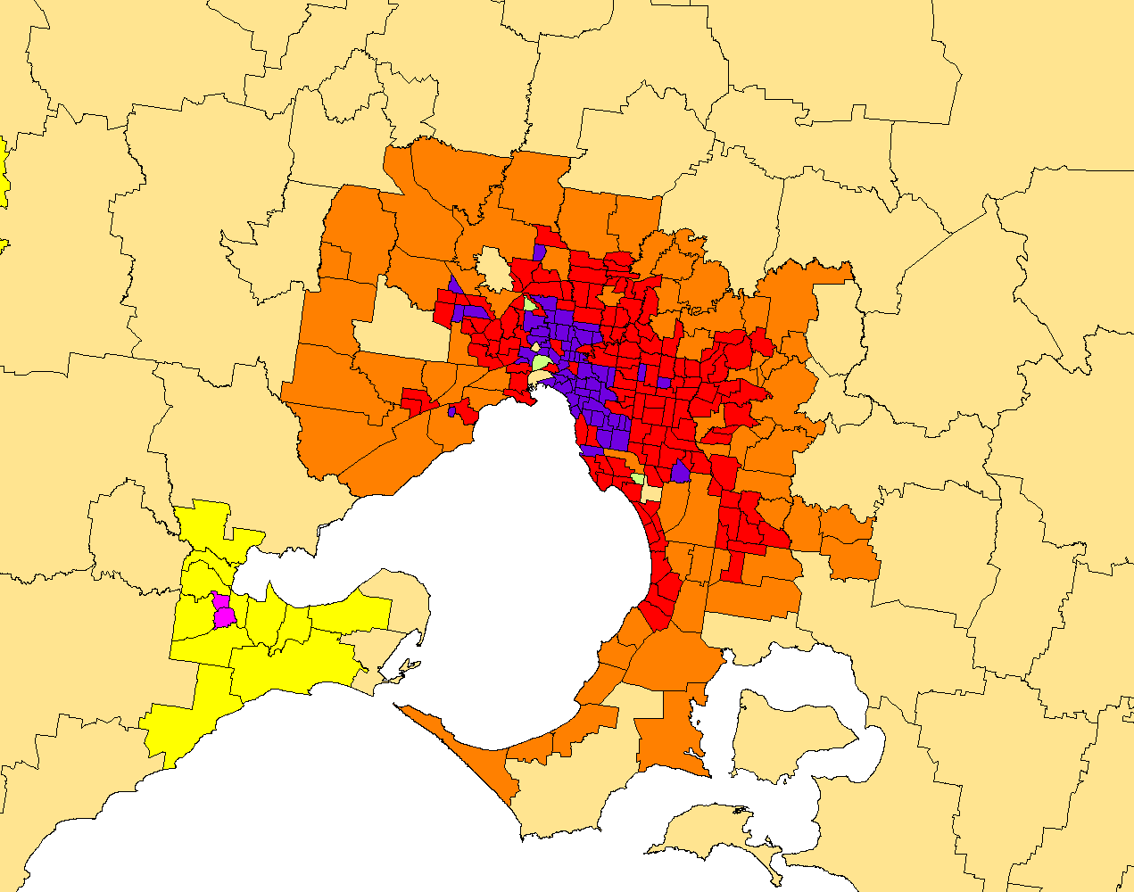
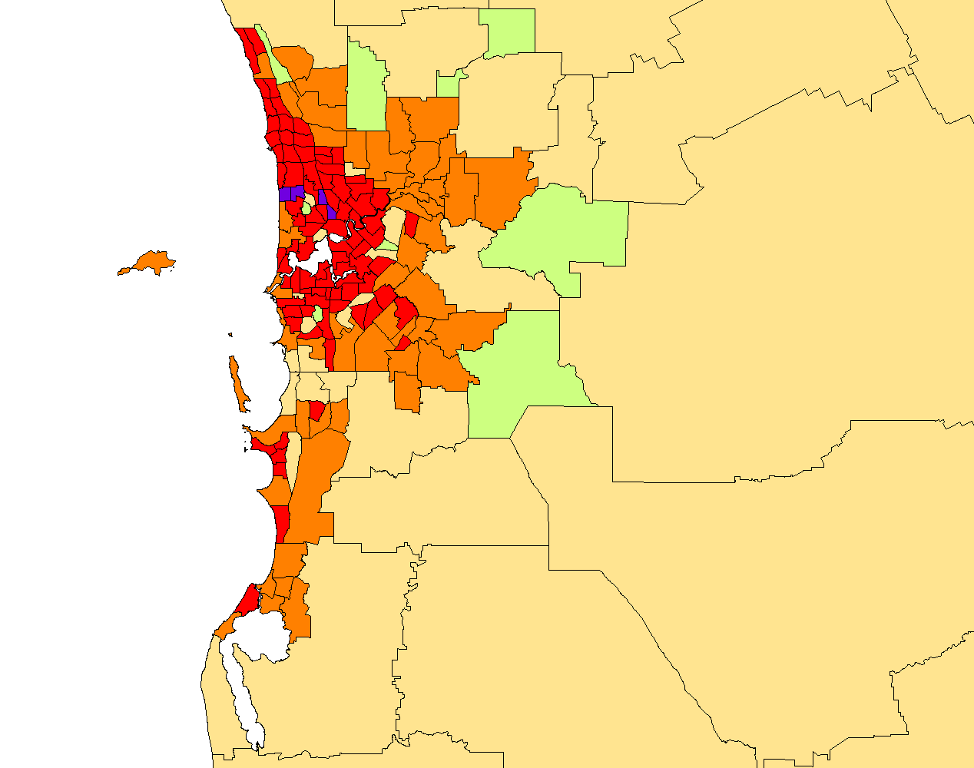
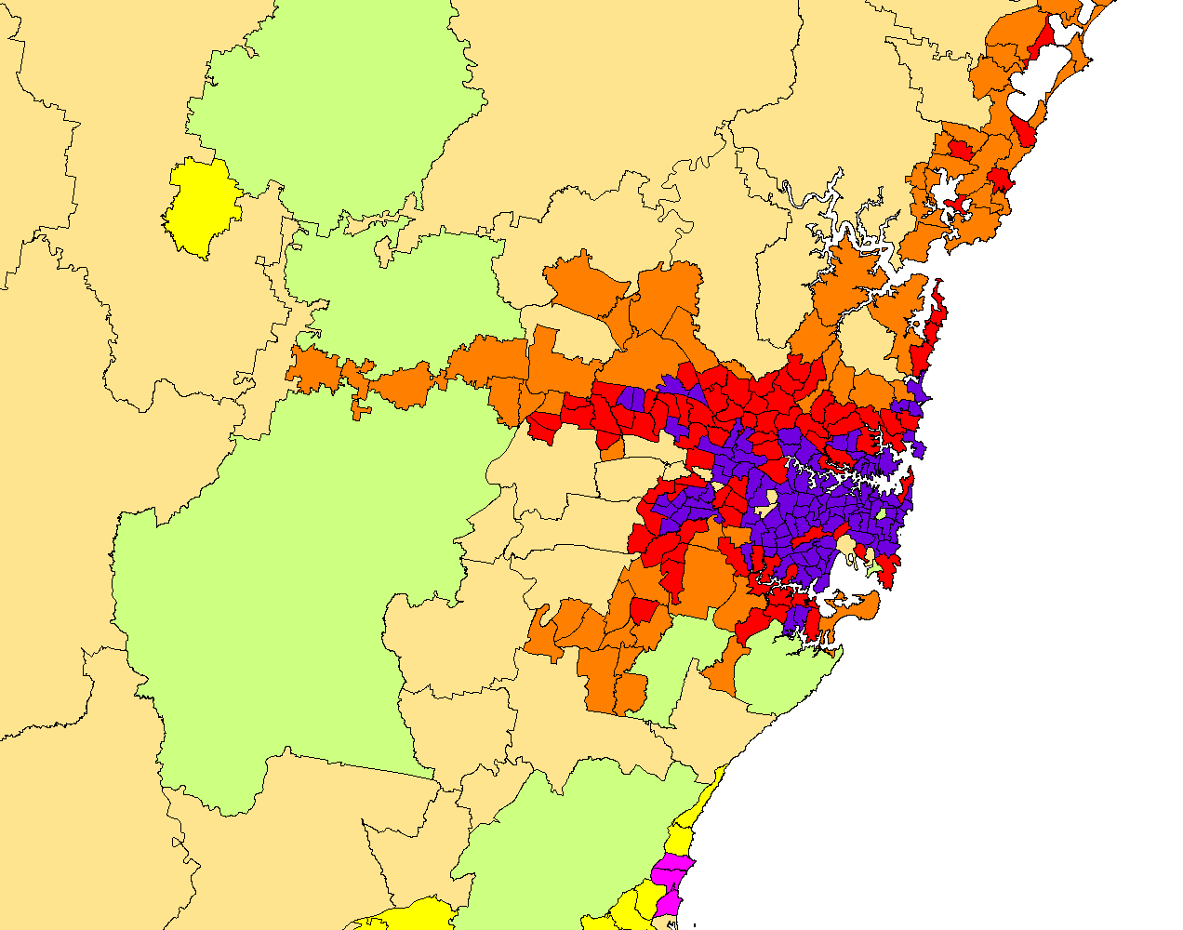
Map of geotypes
Network parameters and assumptions – geotypes
Australia
Adelaide
Brisbane - Gold Coast - Sunshine Coast
Melbourne
Perth
Sydney

Slide 27
Overview
Excel formulae used
Market parameters and assumptions
Network parameters and assumptions
The “CTRL” sheet
The “IN” sheet
Geotypes
National roaming and commuting
Traffic
Coverage
Capacity
Network calculations
Results

Slide 28
National roaming and commuting
Network parameters and assumptions – national roaming and commuting
National roaming
  The model takes into account the national roaming service used by Vodafone on Optus’ network
  It is currently assumed that national roaming is only used in the rural and remote geotypes but this can be modified by updating a single parameter (the calculations to take into account national roaming, if any, are built similarly for all geotypes)
Commuting:
  To take into account commuting, the model contains:
    the proportion of subscribers from the urban, suburban and rural geotypes who commute into denser geotypes (after netting off subscribers who commute in the reverse direction)
    the split of these commuting subscribers into each of the denser geotypes
    the proportion of their traffic generated in these denser geotypes rather than their home geotype
    In denser geotypes the extra traffic from commuters is added on to the traffic generated by residents. However, no corresponding reduction in traffic is made in the geotypes commuters live in; this is to account for the fact that they contribute to two busy hours, at different times of the day, in their home geotype (BH in the evening) and the geotype they commute into (BH in the daytime)

Slide 29
Overview
Excel formulae used
Market parameters and assumptions
Network parameters and assumptions
The “CTRL” sheet
The “IN” sheet
Geotypes
National roaming and commuting
Traffic
Coverage
Capacity
Network calculations
Results

Slide 30
Traffic parameters
Network parameters and assumptions – traffic
These parameters are contained in the “Busy hour calculation” section of the “IN” sheet
Busy hour:
  Values based on typical figures for mobile industry:
    7% for voice
    7% for data; sensitivity at 11%
Share of downlink traffic
  Not indicated for voice as circuit-switched (so implicitly 50%)
  80% for data
IP overheads: 15% for data traffic
In the model these parameters appear as follows:
Data traffic conversion to busy hour traffic |  |  |  |  | Voice | Data
 |  | Busy days per year |  | days | 250 | 365
 |  | Percentage of yearly traffic in these busy days |  |  | 80% | 100%
 |  | Percentage of daily traffic in the busy hour |  | %
 |  |  | Voice (constant over time) |  | 7.0%
 |  |  | Data (may vary over time) |  |  | 7.0%
 |  | Downlink share of traffic |  | % |  | 80%

Slide 31
Overview
Excel formulae used
Market parameters and assumptions
Network parameters and assumptions
The “CTRL” sheet
The “IN” sheet
Geotypes
National roaming and commuting
Traffic
Coverage
Capacity
Network calculations
Results

Slide 32
Coverage parameters
Network parameters and assumptions – coverage
Area coverage: the model contains the area coverage provided by each operator in each geotype and each year as a parameter. For some years, the value is hard coded, for other years it is a calculated curve between two hard-coded values
Population coverage: the population coverage is calculated from the area coverage as follows:
  the SA2s are ordered in decreasing order of population density
  for each geotype, the cumulative area and population coverage are calculated based on the order above
  using an (INDEX, MATCH) function, the model determines the population coverage in each geotype from the area coverage in that geotype
Coverage versus capacity bands:
  For each technology, a coverage band is chosen/determined as a parameter; it is the band with the lowest frequency available for that technology
  This coverage band can vary by year and operator (and by geotype, though this feature is not currently used in the model); for example
    the coverage band for LTE is 1800MHz for all operators until 2014 then becomes 700MHz for Optus and Telstra in 2015 when the 700MHz spectrum becomes available to them
    the coverage band for 3G is 800MHz for Telstra and Vodafone but 900MHz for Optus as Optus does not hold any 800MHz spectrum
  In addition to the coverage band, one or more capacity bands are available for each technology; these are all the other spectrum bands available for that technology
Site radii/areas
  For each band, a cell radius is determined to then obtain a cell coverage area in case this band is used for coverage
  From the cell radius, the cell coverage area is 2.6 x radius², where 2.6 is the “Pi” value for a hexagonal cell

Slide 33
Overview
Excel formulae used
Market parameters and assumptions
Network parameters and assumptions
The “CTRL” sheet
The “IN” sheet
Geotypes
National roaming and commuting
Traffic
Coverage
Capacity
Network calculations
Results

Slide 34
Capacity parameters
Network parameters and assumptions – capacity
Voice and data capacity:
  Voice capacity is calculated in Erlangs: based on the number of TRXs per sector (2G) or R99 traffic channels (3G) and a blocking probability, a capacity in Erlangs is read in an Erlang table (using an (INDEX, MATCH) function)
  Data capacity is based on Mbit/s: the spectral efficiency is multiplied by the amount of spectrum, a utilisation factor, and divided by the amount of traffic on the busiest sector to give the capacity per site in Mbit/s
The spectral efficiency evolves over time as follows in the base case:
  3G: constant at 0.6bit/s/Hz
  4G: as presented in this table:
  As presented earlier in this section (in “the “CTRL” sheet” subsection), two sensitivities can modify the spectral efficiency
      a multiplier of the target value which applies to both 3G and LTE
      a ratio of the low to high frequencies spectral efficiency target value in LTE
2011 | 2012 | 2013 | 2014 | 2015 | 2016 | 2017 | 2018 | 2019 | 2020 | 2021 | 2022 | 2023 | 2024 | 2025 | 2026 | 2027
0.95 | 1.00 | 1.05 | 1.18 | 1.31 | 1.44 | 1.57 | 1.70 | 1.83 | 1.96 | 2.09 | 2.22 | 2.35 | 2.48 | 2.61 | 2.74 | 2.87

Slide 35
Overview
Excel formulae used
Market parameters and assumptions
Network parameters and assumptions
Network calculations
Results

Slide 36
Coverage and capacity sites: definitions
Network calculations
We define the various categories of site as follows:
  Pure coverage site: a site which is required to provide contiguous mobile coverage for a given technology and is only fitted with radio equipment for a single spectrum band (the coverage band for that technology)
  Coverage site with capacity upgrade: a site which started out as a pure coverage site but which has been upgraded with more radio equipment using the same technology to support one or more additional spectrum bands that are used to increase capacity
  Capacity site: a site which is deployed to provide extra capacity in an area that is already covered because the nearby coverage sites cannot carry sufficient traffic despite having been upgraded to the maximum extent possible
For a given operator and technology, the number of physical sites (i.e. masts and roof-tops) is the sum of the pure coverage sites, coverage sites with capacity upgrades, and capacity sites
Note that a single physical site may accommodate multiple technologies and multiple operators so the total number of physical sites for a given operator will be much less than the sum of the logical sites for each technology. Similarly, the total number of physical sites in Australia is less than the sum of the physical sites for each operator

Slide 37
Coverage and capacity sites: calculations
Network calculations
Coverage sites:
  the percentage of area covered in each geotype is multiplied by the total area of the geotype to obtain the area covered
  the area covered is divided by the cell coverage area (described previously) to obtain the number of coverage sites
Uneven traffic distribution within each geotype:
  based on the distribution of traffic on urban sites that is similar to distributions provided by various operators in Australia and elsewhere
  this uneven distribution of traffic per site is used in the base case; however, the model can also be run with an homogeneous distribution of traffic across sites within each geotype
Capacity upgrades:
  if the capacity provided by the coverage band first used on the coverage sites is not sufficient to carry the traffic, capacity upgrades are deployed on the coverage sites
  these capacity upgrades are deployed in one to four capacity bands depending on the technology
  the number of coverage sites with capacity upgrades reported in the results is the number of coverage sites with at least one capacity upgrade (i.e. second and subsequent upgrades are not counted separately)
Capacity sites:
  if the capacity provided by the coverage sites, fully upgraded with all available capacity bands, is not sufficient to carry the traffic, capacity sites are deployed with all bands (the coverage band and all capacity bands) installed at each capacity site

Slide 38
Overview
Excel formulae used
Market parameters and assumptions
Network parameters and assumptions
Network calculations
Results
Where to read them
Macros to run the model
Sensitivities

Slide 39
The “Results” worksheet collates the various network dimensioning and cost results for the operator modelled
Results – where to read them
The results for the active scenario and operator can be seen in the “R - op and scenario selected” worksheet
All these results are linked in from various worksheets of the model: “NW-2G”, “NW-3G”, “NW-LTE” and “NW-backhaul”
It contains the following sections:
  Active equipment: number of BTS, NodeBs and eNodeBs (separately for macrocells and small cells for the latter)
  Sites by technology: number of logical sites for each technology, separately for pure coverage sites, coverage sites with capacity upgrade and capacity sites; for LTE, there is also a distinction between macrosites and small cell sites
  Physical sites: number of total physical sites, new physical sites deployed for LTE, and site upgrades (one upgrade for each technology above the first one on a physical site)
  A summary of the number of sites by technology in 2012 and 2020 (by geotype and type of site) and in 2020 and 2025 (totals by technology only)
  Share of capacity used by type of spectrum: tests the capacity provided by low vs. high frequency bands:
    A high-frequency capacity upgrade installed on a site built for coverage at low frequency is not able to cover the same area so we check what % of traffic the model expects to be carried at different frequencies
    As a rule of thumb, we want there to be sufficient spectrum available in the coverage band and/or sub-1GHz to be able to carry at least 30% of the traffic to ensure that cell edge users are properly serviced. This condition is always met here in the base case and the sensitivities that we have modelled

Slide 40
Overview
Excel formulae used
Market parameters and assumptions
Network parameters and assumptions
Network calculations
Results
Where to read them
Macros to run the model
Sensitivities

Slide 41
A macro produces results for all three operators and another one runs some pre-programmed sensitivities
Results – macros to run the model
The results for the active scenario and operator can be seen in the “R - op and scenario selected” worksheet
To run a scenario for a single operator the following steps need to be followed:
  Select the operator in cell H17 of the “CTRL” sheet
  Select the desired value for each sensitivity in the “Sensitivities” section of the “CTRL” sheet (from row 41)
  Press Ctrl+Alt+F9 to recalculate if the model is not set on automatic calculation
A macro has been built to produce the results for each of the three operators for the scenario selected
  It can be run from the “CTRL” worksheet by pressing the “Run scenario selected for all three operators” button (around cell E10)
  It is necessary to run this macro to obtain the results at the market level as the market results are built by adding the results from each of the three operators for a given scenario
  This macro copies the results for each of the operator in respectively the sheets “R - Optus-sce. selected”,
  “R - Telstra-sce. selected” and “R - VHA-sce. selected” and aggregates them for the whole market in the sheet “R - market-sce. selected”
Another macro calculates and stores the results of the number of logical sites for a list of pre-programmed sensitivities
  It can be run from the “CTRL” worksheet by pressing the “Run sensitivities for total sites count in the market” button (around cell K10)
  The results can be seen in the “R - sites” worksheet
  The list of pre-programmed sensitivities run by the macro is described on the next slide

Slide 42
Overview
Excel formulae used
Market parameters and assumptions
Network parameters and assumptions
Network calculations
Results
Where to read them
Macros to run the model
Sensitivities

Slide 43
The model has many pre-programmed sensitivities. We present a selection of the more important ones here
Results – sensitivities
The results of these sensitivities are contained in the “R - sites” sheet, first for the total market, then for each of the operators separately
These sensitivities are:
  50% or 100% more traffic – illustrates the impact of underestimating future growth in traffic (or reduced offloading to Wi-Fi)
  Increased spectral efficiency (60% higher than base case) – our base case assumption is conservative compared to recent third party estimates for Ofcom in the UK
  No 700MHz or 2.5GHz spectrum – we were asked to consider to what extent a spectrum ‘crunch’ was avoided by the recent 4G auction
  150MHz, 240MHz or 540MHz of additional spectrum released in 2015, at the national level. A release of a further 240MHz or 540MHz as early as 2015 is unlikely, but making this assumption avoids the situation where the model builds additional capacity sites which are soon made redundant by further spectrum releases
  Higher proportion of traffic in the busy hour (11% versus 7%) – illustrates the impact of having much more peaky data traffic in future. Effect is very similar to adding more traffic overall

Slide 44
Contact details
Loïc Tchoukriel-Thébaud
Consultant
Loic.Tchoukriel-Thebaud@analysysmason.com
Philip Bates
Principal
Philip.Bates@analysysmason.com
Analysys Mason Limited Bush House, North West Wing Aldwych, London WC2B 4PJ, UK Tel: +44 (0)20 7395 9000 Fax: +44 (0)20 7395 9001 www.analysysmason.com Registered in England No. 5177472
Boston
Tel: +1 202 331 3080
Fax: +1 202 331 3083
boston@analysysmason.com
Madrid
Tel: +34 91 399 5016
Fax: +34 91 451 8071
madrid@analysysmason.com
Cambridge
Tel: +44 (0)1223 460600
Fax: +44 (0)1223 460866
cambridge@analysysmason.com
Manchester
Tel: +44 (0)161 877 7808
Fax: +44 (0)161 877 7810
manchester@analysysmason.com
Dubai
Tel: +971 (0)4 446 7473
Fax: +971 (0)4 446 9827
dubai@analysysmason.com
Milan
Tel: +39 02 76 31 88 34
Fax: +39 02 36 50 45 50
milan@analysysmason.com
Dublin
Tel: +353 (0)1 602 4755
Fax: +353 (0)1 602 4777
dublin@analysysmason.com
New Delhi
Tel: +91 124 4501860
newdelhi@analysysmason.com
Johannesburg
Tel: +27 11 666 4786
Fax: +27 11 666 4788
johannesburg@analysysmason.com
Paris
Tel: +33 (0)1 72 71 96 96
Fax: +33 (0)1 72 71 96 97
paris@analysysmason.com
London
Tel: +44 (0)20 7395 9000
Fax: +44 (0)20 7395 9001
london@analysysmason.com
Singapore
Tel: +65 6493 6038
Fax: +65 6720 6038
singapore@analysysmason.com
0)1223 460866

